Slide 1
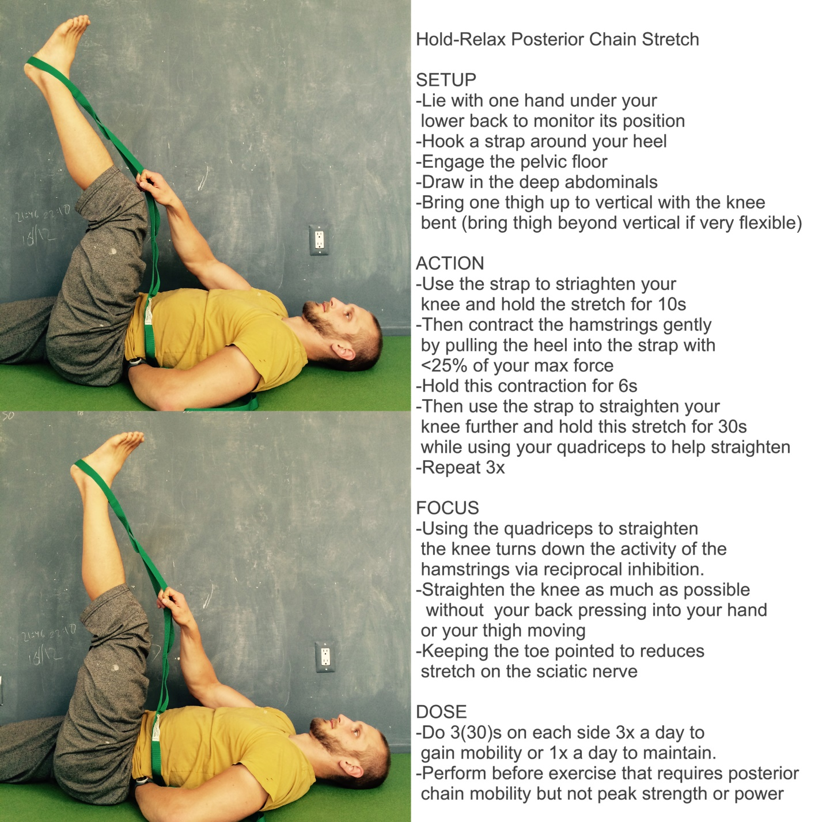

MOBILITY_POSTERIOR-CHAIN:
POPLITEAL ANKLE PNF
Ausinheiler physical therapy & personal Training
26 Eastwood Ct, Oakland, CA 94611
510-842-7135 | bryan@Ausinheiler.com| posturemovementpain.com

