Slide 1
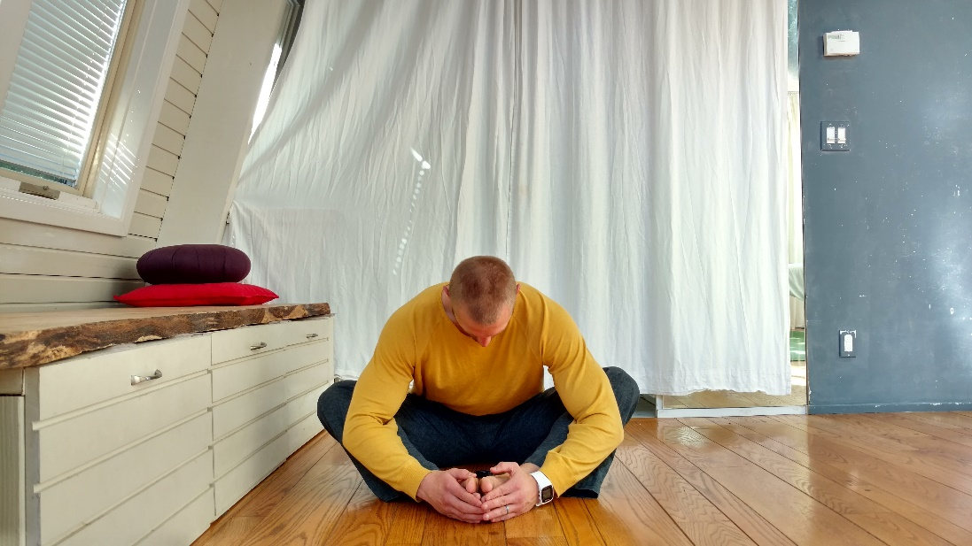

MOBILITY_SPINE_FLX:
Seated butterfly flexion
Setup
Sit with your knees at 90 degrees and the soles of your feet touching each other.
Action
Take a deep belly breath then bend forward as you slowly exhale.
Take two more breaths in the stretch with 4sec inhale and 6sec exhale.
Focus
This exercise stretches the gluteal muscles, hip joint capsule, paraspinal muscles and posterior lumbar ligaments and fascia Relaxing in this position teaches your nervous system to tolerate a greater range of motion.
Dose
1-3x/day 3(30)sec
Ausinheiler physical therapy & personal Training
26 Eastwood Ct, Oakland, CA 94611
510-842-7135 | bryan@Ausinheiler.com| posturemovementpain.com

